Slide 1
Enterprise Data Science Bootcamp Human Resources Analysis Predict Attrition December 2019
Bruno Candeias | David Oliveira | Henrique Pereira | Manuel Oom
M20180313 | M20181430 | M20181395 | M20181431

Slide 2






Agenda
The agenda for today will have the following 5 topics:
Why?
Planning & Methodology
Dataset Exploration
Model Selection
Results
Conclusions
Why did we choose the Human Resources Analysis Project?
What was our Schedule?
What was our approach?
How did we explored our dataset?
What have we discovered?
The selection of the model and why?
What were the results?
What did we concluded?
What will the stakeholder going to do next?

Slide 3

Why “HR Analysis - Predict Attrition”?
It allows the usage of what has been learned, develop different algorithms to achieve a broader view of the problem and to do a descriptive, predictive and prescriptive analysis of a well known concern for companies.
Descriptive
Analytics
Predictive
Analytics
Prescriptive Analytics
Logistic Regression Classifier
Linear Support Vector Classification
C-Support Vector Classification
Human Resources turnover is very present in our professional life and we would like to know:
Who is going to leave the company? (Predictive Analytics)
What measures can we develop to avoid attrition? (Prescriptive Analytics)
XDBoost
Random Forest Classifier
Classification Neural Network

Slide 4
Planning
A plan was develop at the beginning of the project and was carefully followed in order to fulfill the stakeholders deadlines.
16/Oct
23/Oct
30/Oct
06/Nov
13/Nov
20/Nov
27/Nov
04/Dec
11/Dec
Collection
Status Report
Visualization
Now
Cleansing
Engineering
Interim Presentation
Development
Status Report
Selection
Report and Results Presentation
Results

Slide 5
Methodology
The methodology was divided in 7 steps: Collection, Visualization, Cleansing, Engineering, Development, Selection and Results.
Data Source
Data Exploration
Model Evaluation & Selection
Results
Collection
Visualization
Cleansing
Engineering
Development
Selection
Results
Data Collection
Visualization
Data treatment
Feature Engineering
Model development and optimization
Model
Selection
Results Analysis & Conclusions
The dataset was provided by BI4All to develop a case study. There was no need for data search or data gathering
The dataset was firstly analyzed in Power BI to achieve insights and to better understand the dataset
The dataset was quite clean. Some columns were renamed and others were drop. Additionally, normalization was performed with Min-Max Scaler
Categorical variables were transformed into dummy ones and some variables were created to gather non-explanatory variables
Each model was developed and optimize to define the best hyperparameters to achieve the best results
After achieving the best results of each model, a analysis will be performed to select the best model to answer the questions
Once the analysis of the results is completed, a presentation for the stakeholders will be prepared with conclusions and next steps.

Slide 6




Methodology
GithHub collaborative platform was elect to support the development of the project, Python was the programming language and Power Bi was used for data exploration and results presentation.
Data Sources
Data Exploration
Model Evaluation & Selection
Results Presentation

Slide 7

Data Source
Data Source
Data Exploration
Model Evaluation & Selection
Results
Collection
Visualization
Cleansing
Engineering
Development
Selection
Results
The dataset contains information about the employees of multi-national company that works in consultancy area.
Data Source
Data Exploration
Model Evaluation & Selection
Results
Collection
Visualization
Cleansing
Engineering
Development
Selection
Results
Data Collection
The dataset that will be used in the use case contains 1470 records with 35 columns:
The dataset was provided by BI4All to develop a case study. There was no need for data search or data gathering
• Age
• Attrition
• BusinessTravel
• DailyRate
• Department
• DistanceFromHome
• Education
• EducationField
• EmployeeCount
• EmployeeNumber
• EnvironmentSatisfaction
• Gender
• HourlyRate
• JobInvolvement
• JobLevel
• JobRole
• JobSatisfaction
• MaritalStatus
• MonthlyIncome
• MonthlyRate
• NumCompaniesWorked
• Over18
• OverTime
• PercentSalaryHike
• PerformanceRating
• RelationshipSatisfaction
• StandardHours
• StockOptionLevel
• TotalWorkingYears
• TrainingTimesLastYear
• WorkLifeBalance
• YearsAtCompany
• YearsInCurrentRole
• YearsSinceLastPromotion
• YearsWithCurrManager

Slide 8
Data Source
Data Source
Data Exploration
Model Evaluation & Selection
Results
Collection
Visualization
Cleansing
Engineering
Development
Selection
Results
The dataset has some limitations that prevents the achievement of better results
Data Source
Data Exploration
Model Evaluation & Selection
Results
Collection
Visualization
Cleansing
Engineering
Development
Selection
Results
Data Collection
The dataset was provided by BI4All to develop a case study. There was no need for data search or data gathering
Assumptions & Limitations
The dataset is lacking some variables that would be very important:
The true motives for leaving the company;
The conditions that others companies are offering the employees;
Hierarchy superior of the employee ( It is possible to know for how many years they are with them but it is not possible to know who is that person);
Time stamps (date of hiring and date of quitting; data of promotions; data of salaries hike);
Historical Data of promotion;

Slide 9
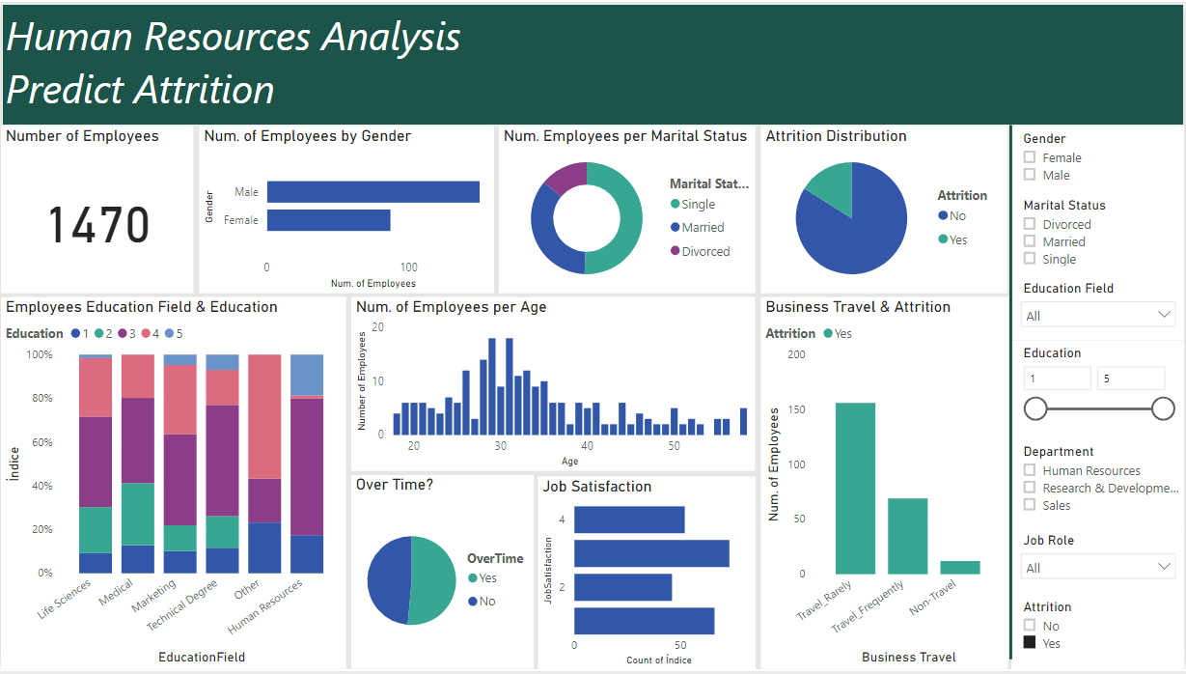

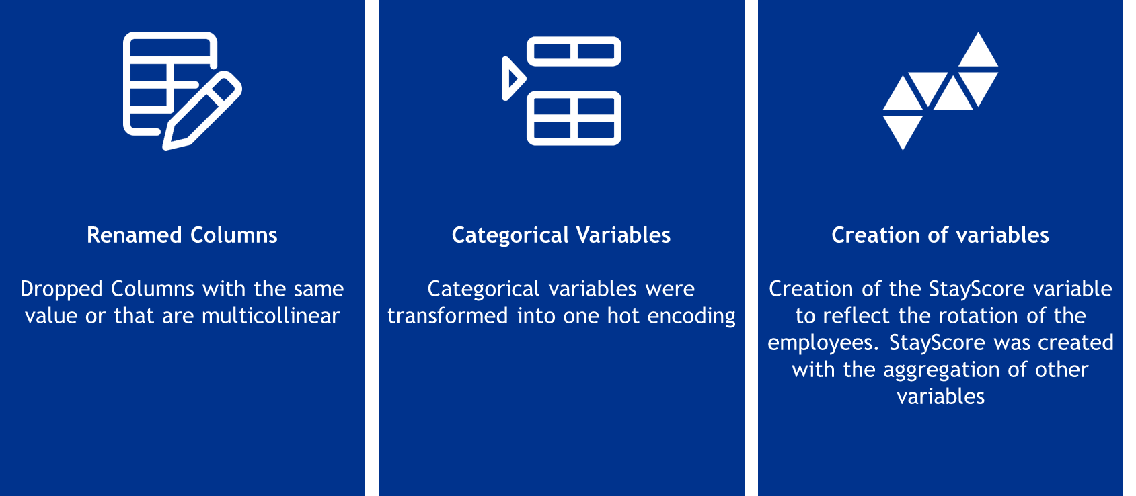
Dataset Exploration
Data Source
Data Exploration
Model Evaluation & Selection
Results
Collection
Visualization
Cleansing
Engineering
Development
Selection
Results
Data exploration has 3 steps: Visualization, Cleansing, Engineering
Data Source
Data Exploration
Model Evaluation & Selection
Results
Collection
Visualization
Cleansing
Engineering
Development
Selection
Results
Visualization
Data treatment
Feature Engineering
The dataset was firstly analyzed in Power BI to achieve insights and to better understand the dataset
The dataset was quite clean. Some columns were renamed and others were drop. Additionally, normalization was performed with Min-Max Scaler
Categorical variables were transformed into dummy and
StayScore variable was created to reflect the rotation of the employees to group other variables

Slide 10

Visualization
Data Source
Data Exploration
Model Evaluation & Selection
Results
Collection
Visualization
Cleansing
Engineering
Development
Selection
Results
Power BI also allowed to get more insight on characteristics of the employees who left the company and compared them with the employees who didn’t left:
Inserir Power BI sem filtros
 | Attrition Yes | Total Dataset | Attrition Yes
Nº of employees:
 | 237 | 1470 | 1233
Age
 | 34 | 37 | 38
Average Income
 | 4800 | 6500 | 6800
Gender Distribution
Male Fem | 63% 37% | 60% 40% | 60% 40%
Marital Status
Marr Sing Divo | 35% 51% 14% | 46% 32% 22% | 48% 28% 24%
Job Satisfaction
1 2 3 4 | 22% 31% 19% 28% | 31% 30% 19% 20% | 33% 30% 19% 18%
Overtime
Yes No | 54% 46% | 28% 50% | 23% 77%

Slide 11



Cleansing and Engineering
Data Source
Data Exploration
Model Evaluation & Selection
Results
Collection
Visualization
Cleansing
Engineering
Development
Selection
Results
The treatment of the dataset was performed with the following data Cleansing and Feature Engineering activities:
Renamed Columns
Dropped Columns with the same value or that are multicollinear
Categorical Variables
Categorical variables were transformed into one hot encoding
Creation of variables
Creation of the StayScore variable to reflect the rotation of the employees. StayScore was created with the aggregation of other variables

Slide 12
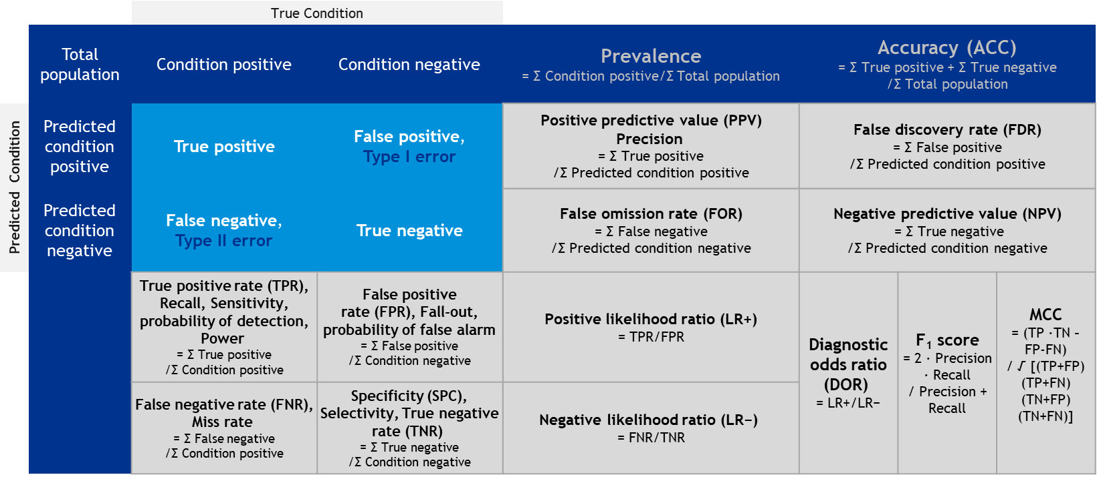
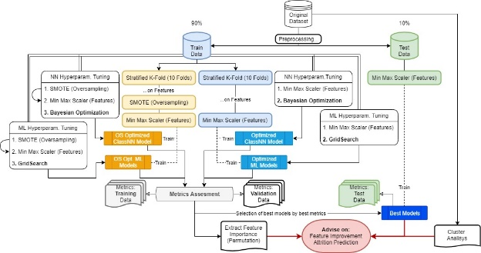
Model Evaluation & Selection
Data Source
Data Exploration
Model Evaluation & Selection
Results
Collection
Visualization
Cleansing
Engineering
Development
Selection
Results
The Model Evaluation & Selection has 2 steps: Model development and optimization and model selection.
Data Source
Data Exploration
Model Evaluation & Selection
Results
Collection
Visualization
Cleansing
Engineering
Development
Selection
Results
Model development and optimization
Model
Selection
Logistic Regression Classifier
Linear Support Vector Classification
C-Support Vector Classification
XDBoost
Random Forest Classifier
Classification Neural Network
Each model was developed and optimize to define the best hyperparameters to achieve the best results
After achieving the best results of each model, a analysis will be performed to select the best model to answer the questions

Slide 13
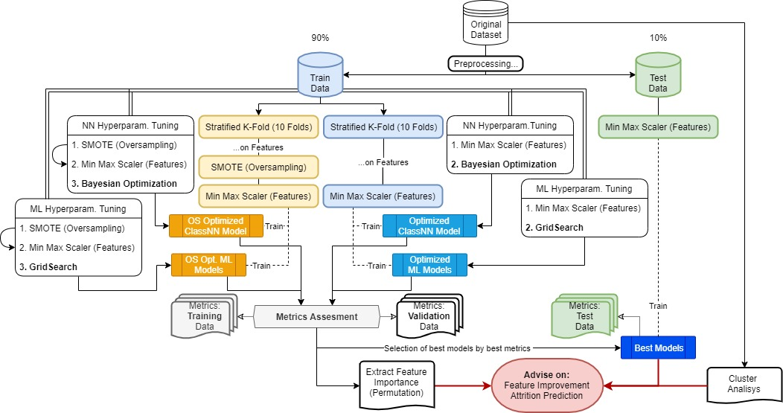
Model Development
Data Source
Data Exploration
Model Evaluation & Selection
Results
Collection
Visualization
Cleansing
Engineering
Development
Selection
Results
The iterative process of the models development followed the diagram:

Slide 14
Score Selection
Data Source
Data Exploration
Model Evaluation & Selection
Results
Collection
Visualization
Cleansing
Engineering
Development
Selection
Results
In theoretical terms, there are a lot of scores to consider when selecting the model. Normally, the F₁ score is the one that is used to selected the best models but...
 |  | True Condition
 | Total population | Condition positive | Condition negative | Prevalence = Σ Condition positive/Σ Total population | Accuracy (ACC) = Σ True positive + Σ True negative /Σ Total population
Predicted Condition | Predicted condition positive | True positive | False positive, Type I error | Positive predictive value (PPV) Precision = Σ True positive /Σ Predicted condition positive | False discovery rate (FDR) = Σ False positive /Σ Predicted condition positive
 | Predicted condition negative | False negative, Type II error | True negative | False omission rate (FOR) = Σ False negative /Σ Predicted condition negative | Negative predictive value (NPV) = Σ True negative /Σ Predicted condition negative
 |  | True positive rate (TPR), Recall, Sensitivity, probability of detection, Power = Σ True positive /Σ Condition positive | False positive rate (FPR), Fall-out, probability of false alarm = Σ False positive /Σ Condition negative | Positive likelihood ratio (LR+) = TPR/FPR | Diagnostic odds ratio (DOR) = LR+/LR− | F₁ score = 2 · Precision · Recall / Precision + Recall | MCC = (TP ·TN – FP-FN) / √ [(TP+FP) (TP+FN) (TN+FP) (TN+FN)]
 |  | False negative rate (FNR), Miss rate = Σ False negative /Σ Condition positive | Specificity (SPC), Selectivity, True negative rate (TNR) = Σ True negative /Σ Condition negative | Negative likelihood ratio (LR−) = FNR/TNR
MCC - Matthews correlation coefficient

Slide 15
Score Selection
Data Source
Data Exploration
Model Evaluation & Selection
Results
Collection
Visualization
Cleansing
Engineering
Development
Selection
Results
MCC is more informative than any other confusion matrix measure in evaluating binary classification problems because it takes into account the balance ratios of the 4 confusion matrix categories (TP, TN, FP and FN)
 |  | True Condition
 | Total population | Condition positive | Condition negative | Prevalence = Σ Condition positive/Σ Total population | Accuracy (ACC) = Σ True positive + Σ True negative /Σ Total population
Predicted Condition | Predicted condition positive | True positive | False positive, Type I error | Positive predictive value (PPV) Precision = Σ True positive /Σ Predicted condition positive | False discovery rate (FDR) = Σ False positive /Σ Predicted condition positive
 | Predicted condition negative | False negative, Type II error | True negative | False omission rate (FOR) = Σ False negative /Σ Predicted condition negative | Negative predictive value (NPV) = Σ True negative /Σ Predicted condition negative
 |  | True positive rate (TPR), Recall, Sensitivity, probability of detection, Power = Σ True positive /Σ Condition positive | False positive rate (FPR), Fall-out, probability of false alarm = Σ False positive /Σ Condition negative | Positive likelihood ratio (LR+) = TPR/FPR | Diagnostic odds ratio (DOR) = LR+/LR− | F₁ score = 2 · Precision · Recall / Precision + Recall | MCC = (TP ·TN – FP-FN) / √ [(TP+FP) (TP+FN) (TN+FP) (TN+FN)]
 |  | False negative rate (FNR), Miss rate = Σ False negative /Σ Condition positive | Specificity (SPC), Selectivity, True negative rate (TNR) = Σ True negative /Σ Condition negative | Negative likelihood ratio (LR−) = FNR/TNR
MCC - Matthews correlation coefficient

Slide 16
Score Selection “Who is going to leave the company?“
Data Source
Data Exploration
Model Evaluation & Selection
Results
Collection
Visualization
Cleansing
Engineering
Development
Selection
Results
However, to answer the question “Who is going to leave the company?“ the TPR and the PPV scores must also be considered. The TPR scores indicates the percentage of positives found (without considering the false positives). The PPV shows the ratio of true positives in the predicted positives.
 |  | True Condition
 | Total population | Condition positive | Condition negative | Prevalence = Σ Condition positive/Σ Total population | Accuracy (ACC) = Σ True positive + Σ True negative/Σ Total population
Predicted Condition | Predicted condition positive | True positive | False positive, Type I error | Positive predictive value (PPV) Precision = Σ True positive /Σ Predicted condition positive | False discovery rate (FDR) = Σ False positive /Σ Predicted condition positive
 | Predicted condition negative | False negative, Type II error | True negative | False omission rate (FOR) = Σ False negative /Σ Predicted condition negative | Negative predictive value (NPV) = Σ True negative /Σ Predicted condition negative
 |  | True positive rate (TPR), Recall, Sensitivity, probability of detection, Power = Σ True positive /Σ Condition positive | False positive rate (FPR), Fall-out, probability of false alarm = Σ False positive /Σ Condition negative | Positive likelihood ratio (LR+) = TPR/FPR | Diagnostic odds ratio (DOR) = LR+/LR− | F₁ score = 2 · Precision · Recall / Precision + Recall | MCC = (TP ·TN – as FP-FN) / √ [(TP+FP) (TP+FN) (TN+FP) (TN+FN)]
 |  | False negative rate (FNR), Miss rate = Σ False negative /Σ Condition positive | Specificity (SPC), Selectivity, True negative rate (TNR) = Σ True negative/ Σ Condition negative | Negative likelihood ratio (LR−) = FNR/TNR
Who is going to leave the company?
“Prisoner’s Dilemma” adapted to the HR - Attrition Case: What do you prefer?
Identify someone who wasn’t going to leave the company as “Potential attrition”
OR
Don’t identify someone who is going to leave the company
In terms of numbers the dilemma can be presented as follow: What do you prefer?
Identify 3 persons who wasn’t going to leave the company as “Potential attrition” (3 false positives)
OR
Don’t identify 1 person who is going to leave the company (1 false negative)

Slide 17

Data Source
Data Exploration
Model Evaluation & Selection
Results
Collection
Visualization
Cleansing
Engineering
Development
Selection
Results
Score Selection “What can we do to avoid attrition?”
For the question “What can we do to avoid attrition?”, the most important features for the 2 top models must be found in order to be mitigated. The scores can’t help with the answer.
 |  | True Condition
 | Total population | Condition positive | Condition negative | Prevalence = Σ Condition positive/Σ Total population | Accuracy (ACC) = Σ True positive + Σ True negative /Σ Total population
Predicted Condition | Predicted condition positive | True positive | False positive, Type I error | Positive predictive value (PPV) Precision = Σ True positive /Σ Predicted condition positive | False discovery rate (FDR) = Σ False positive /Σ Predicted condition positive
 | Predicted condition negative | False negative, Type II error | True negative | False omission rate (FOR) = Σ False negative /Σ Predicted condition negative | Negative predictive value (NPV) = Σ True negative /Σ Predicted condition negative
 |  | True positive rate (TPR), Recall, Sensitivity, probability of detection, Power = Σ True positive /Σ Condition positive | False positive rate (FPR), Fall-out, probability of false alarm = Σ False positive /Σ Condition negative | Positive likelihood ratio (LR+) = TPR/FPR | Diagnostic odds ratio (DOR) = LR+/LR− | F₁ score = 2 · Precision · Recall / Precision + Recall | MCC = (TP ·TN – FP-FN) / √ [(TP+FP) (TP+FN) (TN+FP) (TN+FN)]
 |  | False negative rate (FNR), Miss rate = Σ False negative /Σ Condition positive | Specificity (SPC), Selectivity, True negative rate (TNR) = Σ True negative /Σ Condition negative | Negative likelihood ratio (LR−) = FNR/TNR
MCC - Matthews correlation coefficient

Slide 18
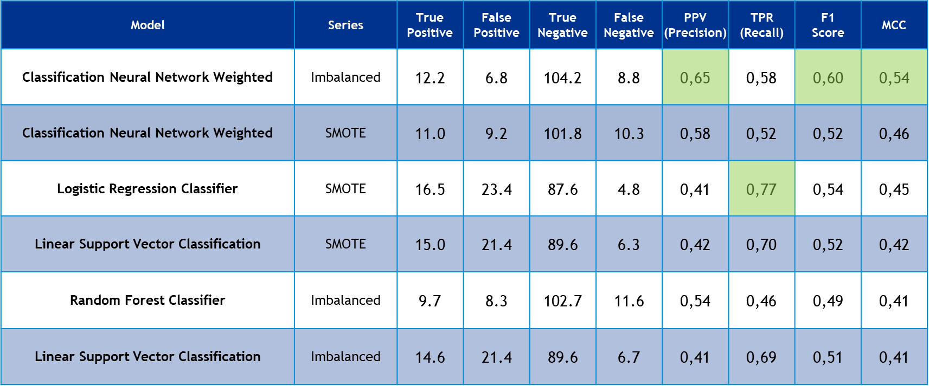




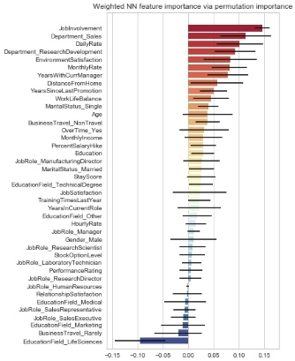
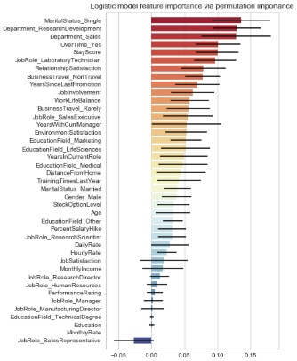
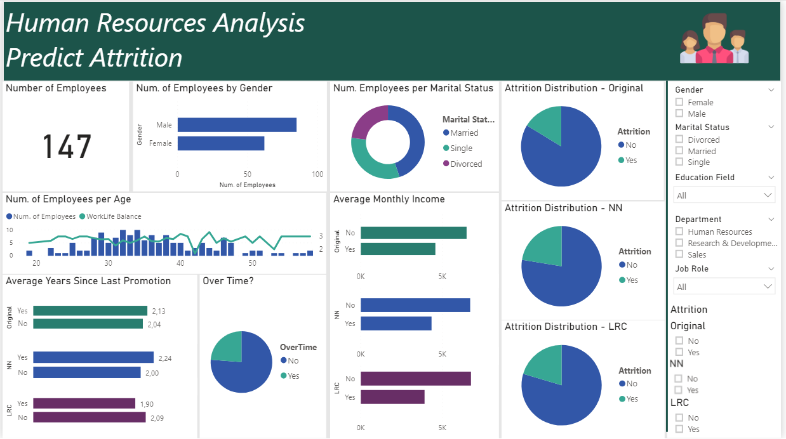
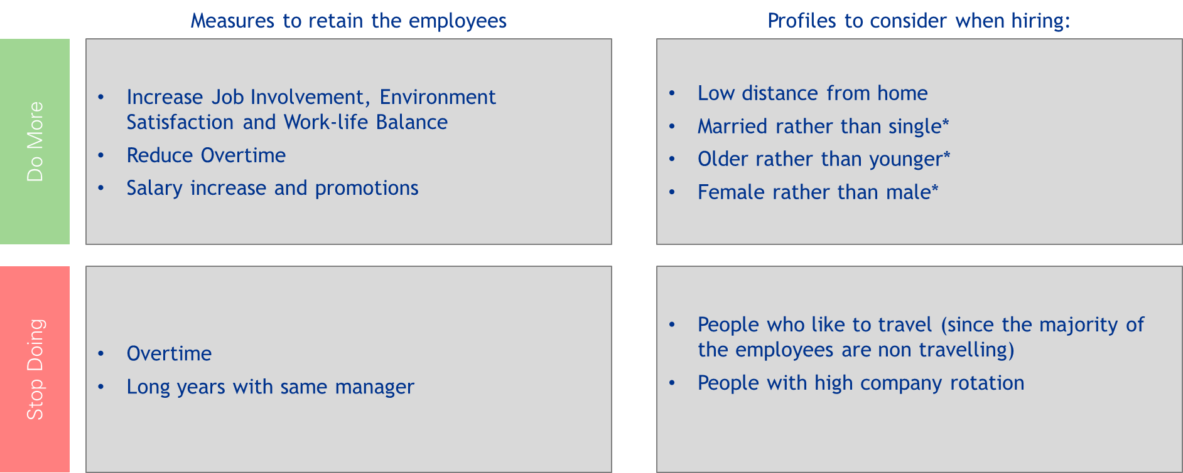
Results
Data Source
Data Exploration
Model Evaluation & Selection
Results
Collection
Visualization
Cleansing
Engineering
Development
Selection
Results
The results analysis & conclusions identified the most important features and presented solutions to what can be done to avoid attrition and evaluate the success of the attrition mitigation measures.
Data Source
Data Exploration
Model Evaluation & Selection
Results
Collection
Visualization
Cleansing
Engineering
Development
Selection
Results
Results Analysis & Conclusions
Once the analysis of the results is completed, a presentation for the stakeholders will be prepared with conclusions and next steps.

Slide 19



Who is going to leave the company?
Data Source
Data Exploration
Model Evaluation & Selection
Results
Collection
Visualization
Cleansing
Engineering
Development
Selection
Results
A cluster analysis on the original dataset concluded that there are 14 “personas” in the company. 4 of them usually leave the company.
Amy “Trainee”
Bob “Walk to Job”
Clive “Nine to Five”
Joe “we don’t know”
Low average years in the current role
Works in Sales
High overtime
Rarely business travel
Small distance from home
Works in research
Low monthly income
Low average years in the current role
Below average work-life balance
Low environment satisfaction
High work-life balance
Works in research
Low monthly income
Low salary increase
Low average years in the current role
Low Overtime
Below average education
There were also some employees that couldn’t relate with any cluster and also left the company
Cluster 0
Cluster 14
Cluster 15
Outliers

Slide 20
Model Results
Data Source
Data Exploration
Model Evaluation & Selection
Results
Collection
Visualization
Cleansing
Engineering
Development
Selection
Results
The top 6 best scores of the models are represented in the following table. Maximizing both PPV and TPR we concluded that the best model is the Classification Neural Network, that has the best MCC and the best F₁.
Model | Series | True Positive | False Positive | True Negative | False Negative | PPV (Precision) | TPR (Recall) | F1 Score | MCC
Classification Neural Network Weighted | Imbalanced | 12.2 | 6.8 | 104.2 | 8.8 | 0,65 | 0,58 | 0,60 | 0,54
Classification Neural Network Weighted | SMOTE | 11.0 | 9.2 | 101.8 | 10.3 | 0,58 | 0,52 | 0,52 | 0,46
Logistic Regression Classifier | SMOTE | 16.5 | 23.4 | 87.6 | 4.8 | 0,41 | 0,77 | 0,54 | 0,45
Linear Support Vector Classification | SMOTE | 15.0 | 21.4 | 89.6 | 6.3 | 0,42 | 0,70 | 0,52 | 0,42
Random Forest Classifier | Imbalanced | 9.7 | 8.3 | 102.7 | 11.6 | 0,54 | 0,46 | 0,49 | 0,41
Linear Support Vector Classification | Imbalanced | 14.6 | 21.4 | 89.6 | 6.7 | 0,41 | 0,69 | 0,51 | 0,41
TPR – True positive rate PPV - Positive predictive value

Slide 21
Model Results
Data Source
Data Exploration
Model Evaluation & Selection
Results
Collection
Visualization
Cleansing
Engineering
Development
Selection
Results
Both the predictions of Classification Neural Network (NN) and the Logistic Regression Classifier (LRC) have similar distributions of the monthly income when compared with the original one. For the Years Since Last Promotion the NN performs better.

Slide 22

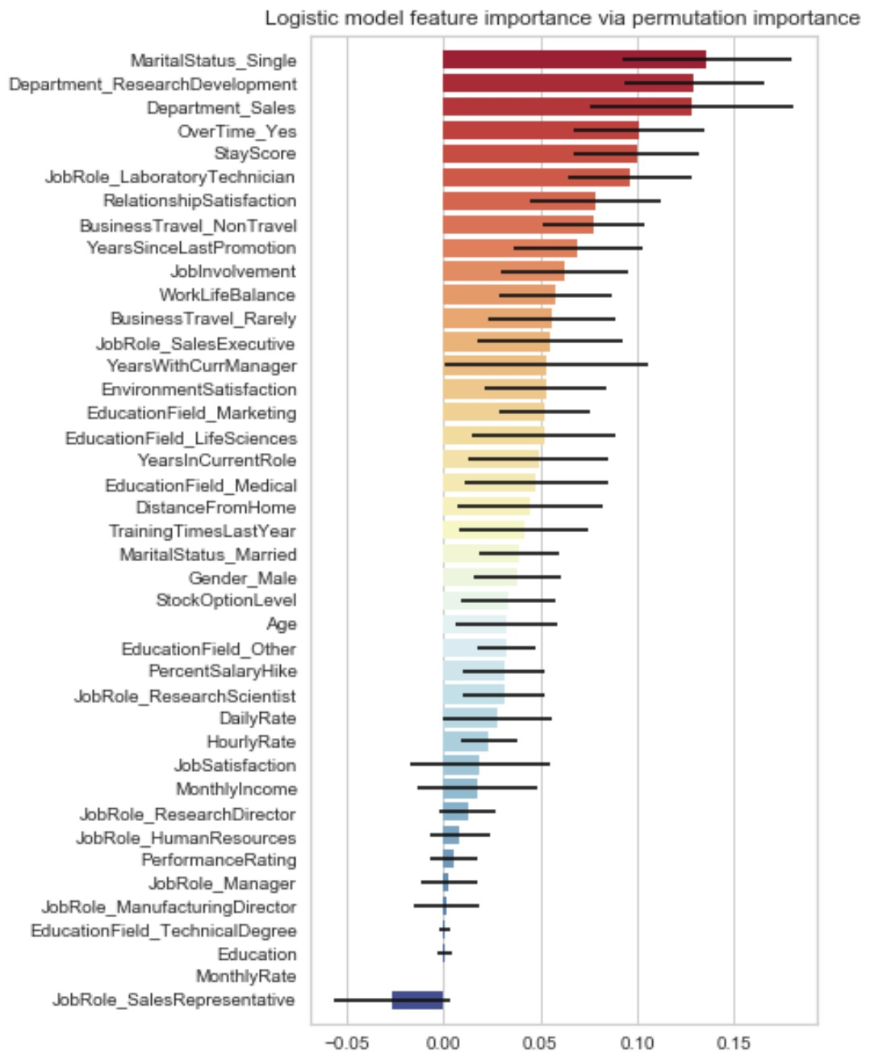
Results | “What can we do to avoid attrition?”
Using a feature permutation importance for both models, the results showed that the most relevant variables that are possible to modify for each model are:
Classification Neural Network
Logistic Regression Classifier
Job Involvement
Daily Rate
Environment Satisfaction
Monthly Rate
Years With Current Manager
Years Since Last Promotion
Work Life Balance
Overtime
Business Travel
Monthly Income
Percent Salary Hike
Overtime
Stay Score
Business Travel
Years Since Last Promotion
Job Involvement
Work Life Balance
Years With Current Manager
Percent Salary Hike
Daily Rate
Hourly Rate
Job Satisfaction

Slide 23
Conclusions
Knowing the most relevant features, it was the time to create a new dataset, increase and decrease some variables, and compare it to the attrition of the first predictions.
Changing this variables
Attrition will reduce by:
Knowing that:
Option 1
Increase Monthly Income (+10%)
Decrease Overtime
Increase Work Life Balance (+1)
Classification Neural Network
Logistic Regression Classifier
10%
27%
The cost of hiring a new employee is estimated to be between 50% and 250%^{[1]} of the cost of a current employee.
According to the models, increasing the salary by 10%, decreasing the overtime to “No” and increasing the Work Life Balance by 1 value, it looks a very good counter-proposal to present to the employees who pretend to leave in order to maintain them.
However, counter-proposals should only be offered to the ones that the company intends to retain.
No
33%
1
Option 2
Increase Monthly Income
Decrease Overtime
Increase Work Life Balance
Years Since Last Promotion
Classification Neural Network
Logistic Regression Classifier
10%
42%
No
1
47%
0
^{[1]} Source: Link

Slide 24
Conclusions
Concluding, the recommendations are to develop the following actions to reduce the attrition and to consider the following characteristics when hiring new employees:
Measures to retain the employees
Profiles to consider when hiring:
Increase Job Involvement
Environment Satisfaction
Work-life Balance
Salary increase and promotions
Low distance from home
More experience rather than low experience
Do More
Overtime
Long years with same manager
People who like to travel (since the majority of the employees are “travelling rarely”)
People with high company rotation
Stop Doing

Slide 25
Thank you!

